Slide 1

Chapter 5 2D&3D geometric transformations
Geometric transformations can change the orientations, size and shape of objects.
Applications: create complex graphics by changing the simple objects; produce animations by moving the camera or the objects.
Basic transformations: Translation , Rotation and Scaling.
华东师范大学计算机系2005

Slide 2
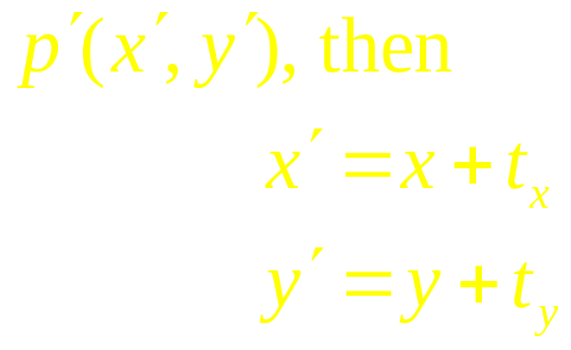
Ch 5 2D geometric transformations
5.1 Basic transformations
Translation
Adding t_{x} and t_{y} to the original coordinate P(x,y) to move the point to a new position
y
t_{y}
object
object
x
t_{x}

Slide 3


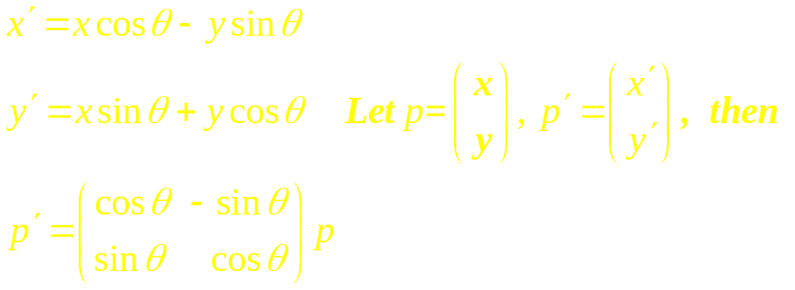
2. Rotation
Rotation of a point from position to position
relative to the origin.
y
θ
x

Slide 4
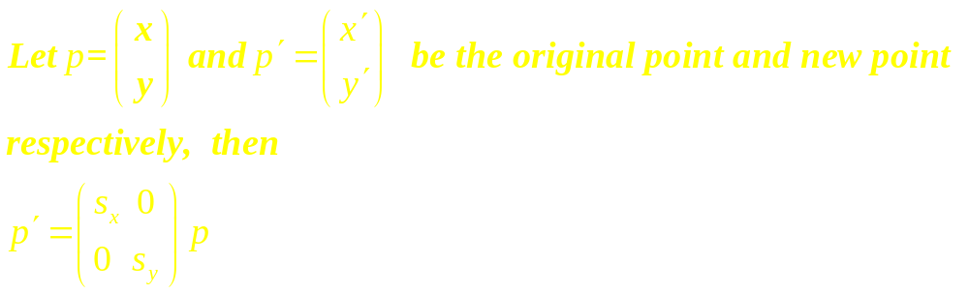
3. Scaling
A scaling transformation alters the size of an object. Let s_{x} and s_{y} be scaling factors.

Slide 5
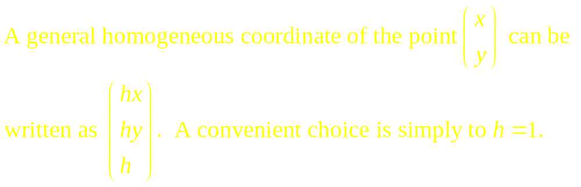
5.2 Matrix presentations and homogeneous coordinate
Note: 1. The homogeneous coordinate corresponding to point
P(x,y) is not unique.
2. The point with h=0 represents finite far point in the 2D plane.

Slide 6
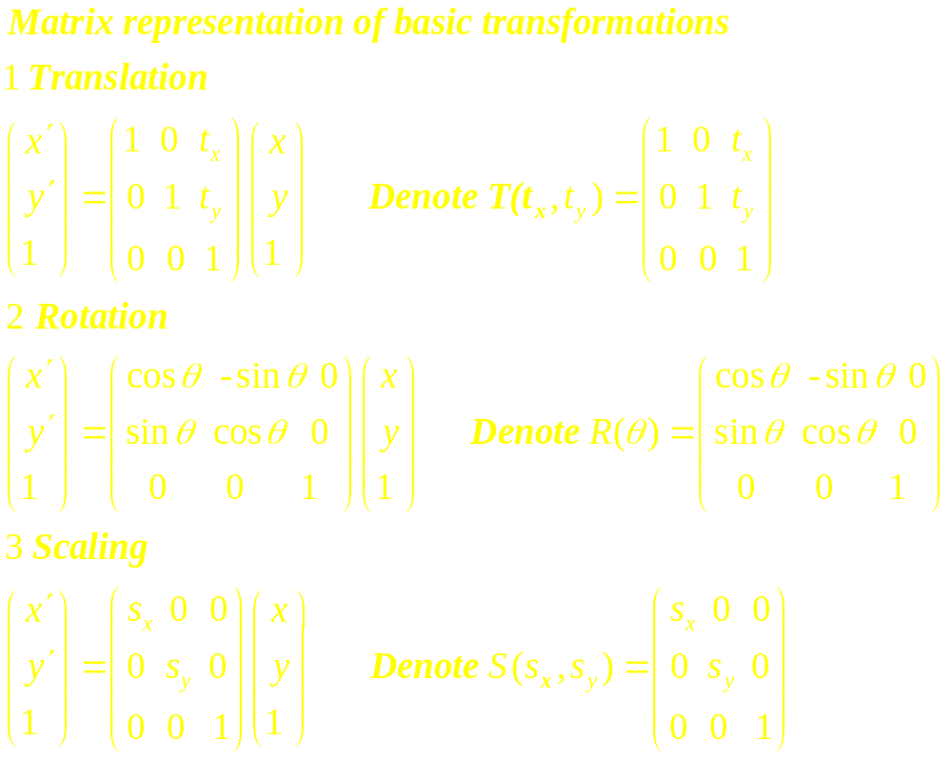

Slide 7
text
text
text
(a)Sx=Sy=1
(b)Sx=Sy<1
text
text
text
text
(c)Sx=Sy<1
(d)Sx=1,Sy>1

Slide 8
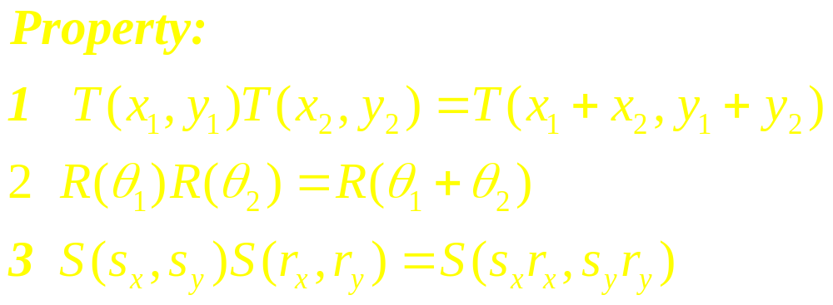
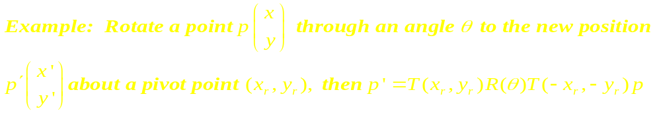
5.3 Composite transformations

Slide 9
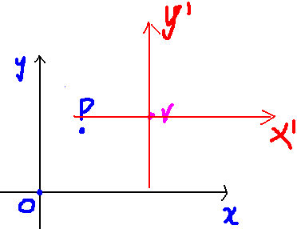
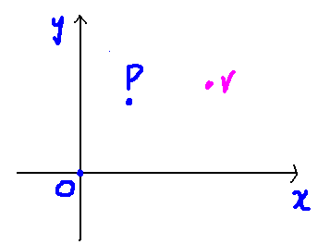
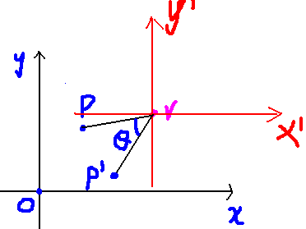
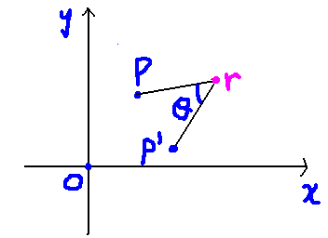

Slide 10
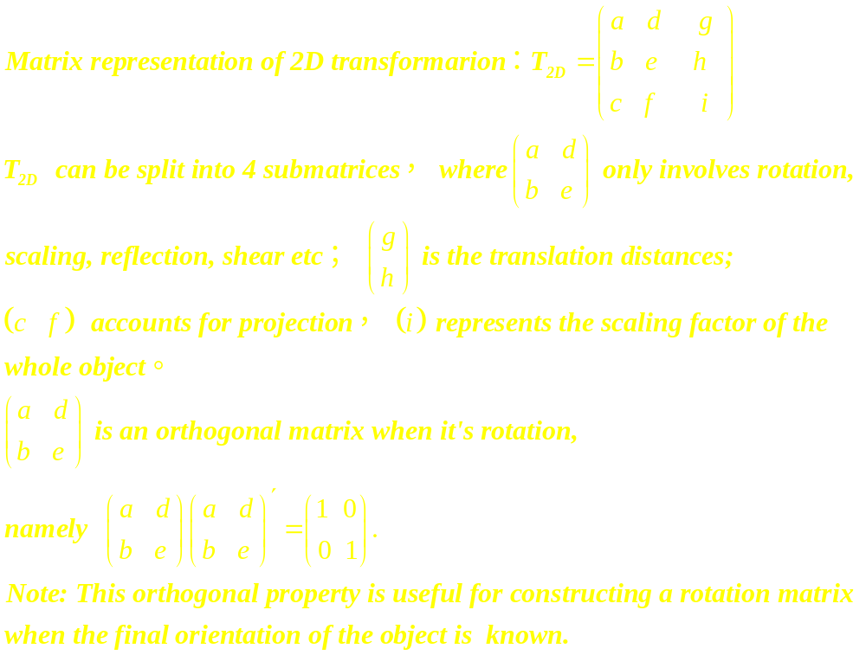

Slide 11
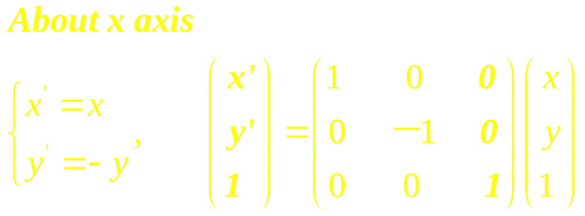
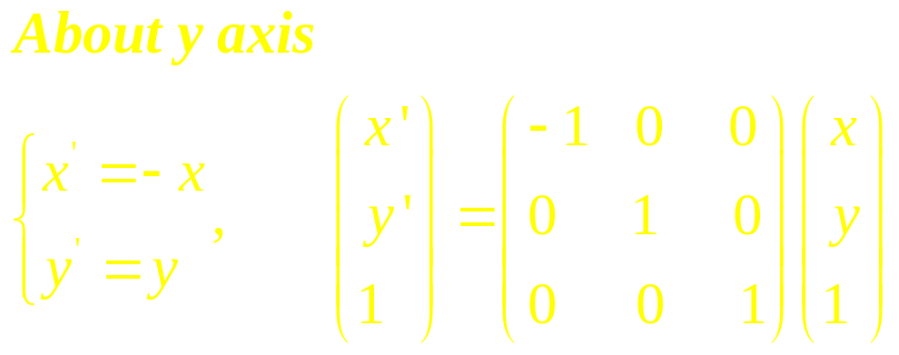
Other transformations
1. Reflection
y
x
y
x

Slide 12
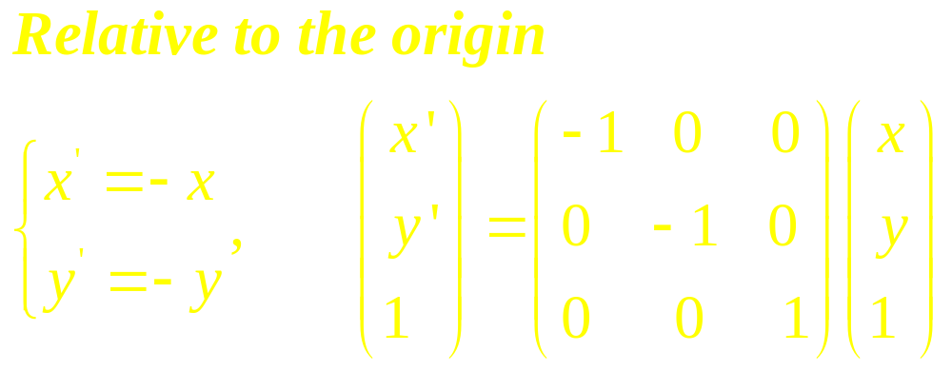
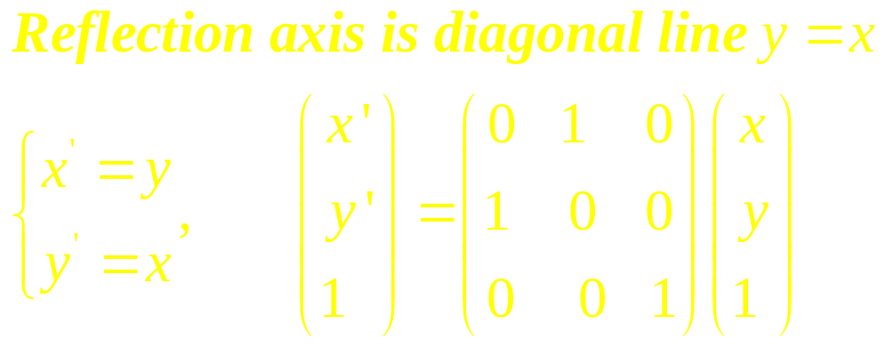
y
x
y
x

Slide 13
2. Shear
A transformation that distorts the shape of an
Object. Two common shearing are those that
shift x values and those that shift y values
y shearing
x shearing

Slide 14
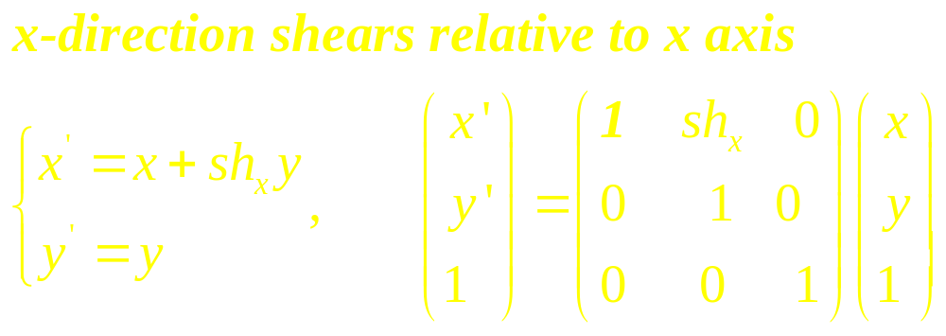
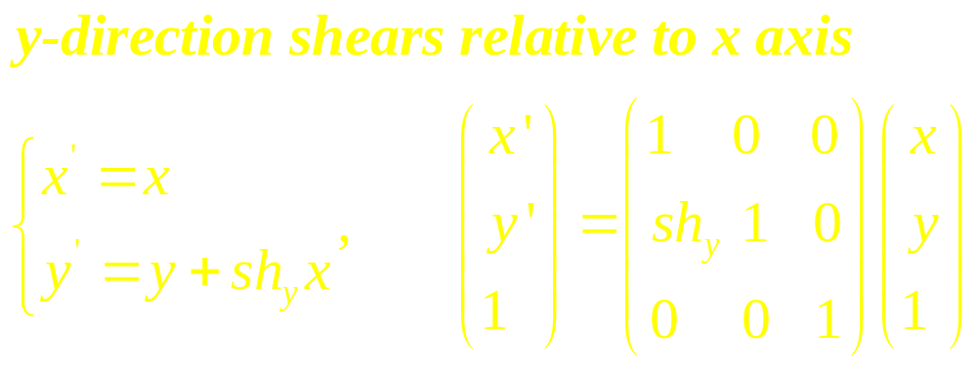
2. Shear

Slide 15
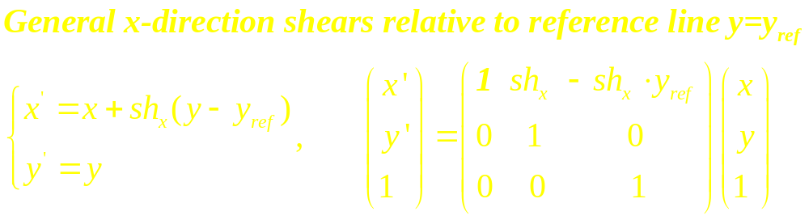
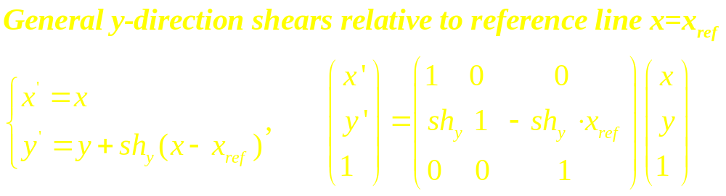

Slide 16
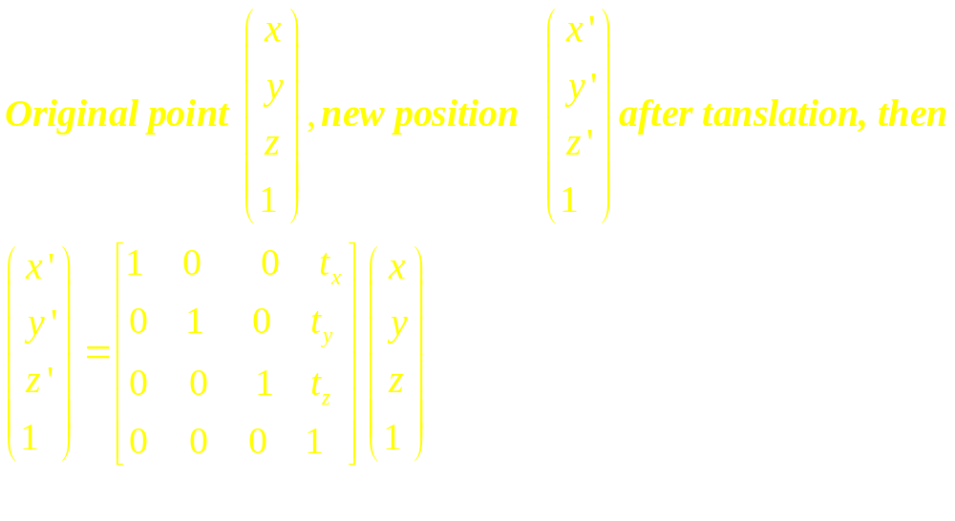
5.9 3D geometric transformations
Basic transformations
1. Translation

Slide 17
2. Rotation
Unlike 2D rotation, 3D rotation can be specified around any line. The easiest rotation axes are parallel to the coordinate axes.
For convention, positive rotation angles produce counterclockwise rotation about a coordinate axis.
y
y
y
View
View
x
View
x
x
z
z
z

Slide 18
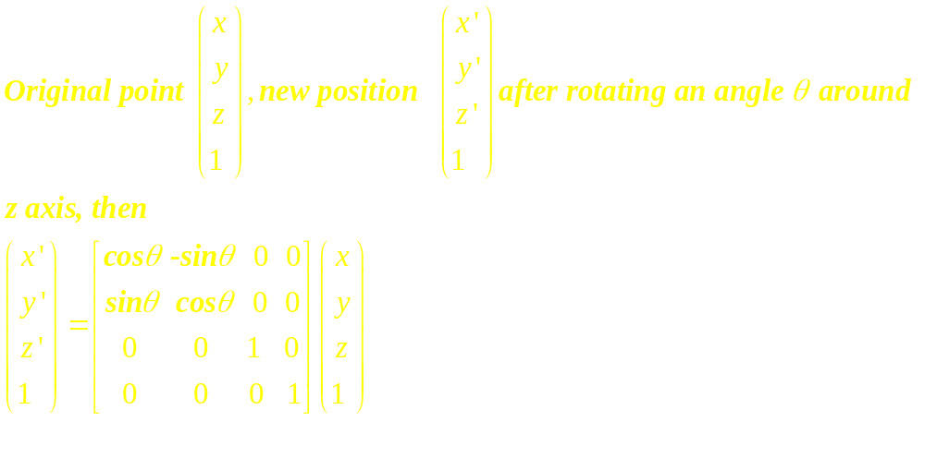

Slide 19
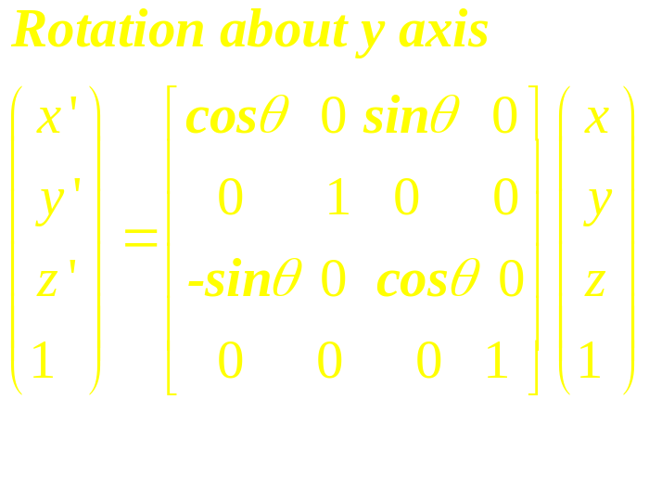
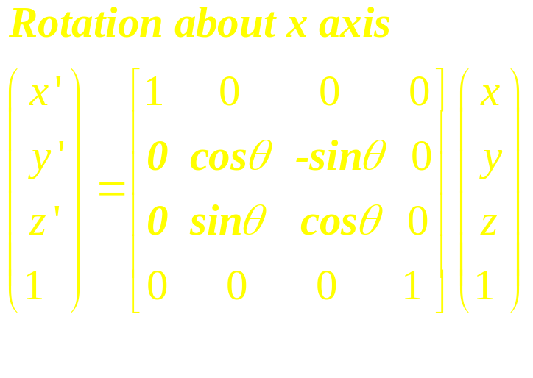

Slide 20
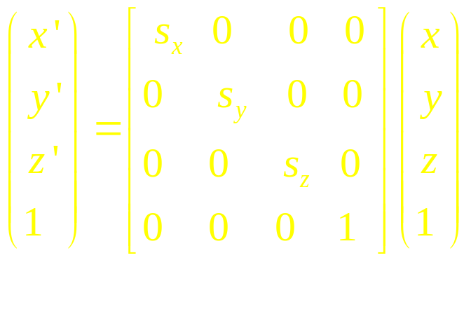
3. Scaling
Other transformations include reflections about xy
Plane, xz plane, yz plane and shears etc. Similarly,
there are 3D composite transformations.

Slide 21
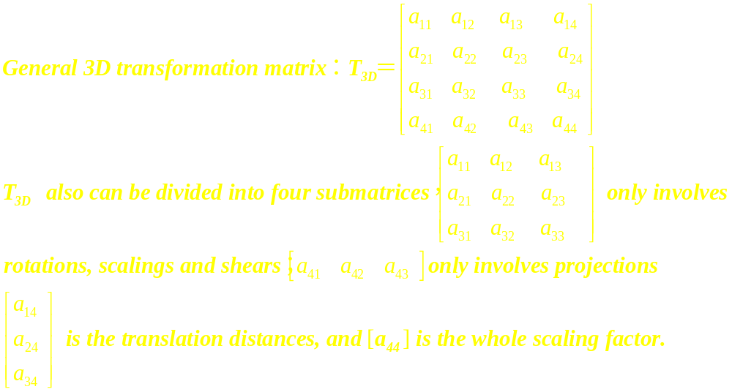

Slide 22
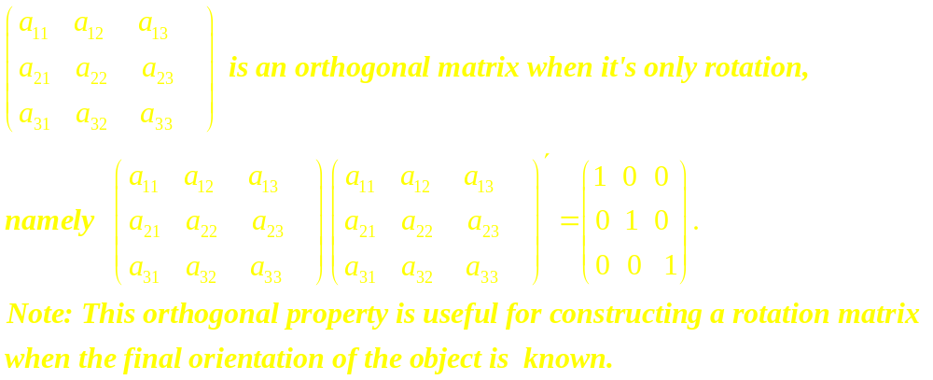

Slide 23
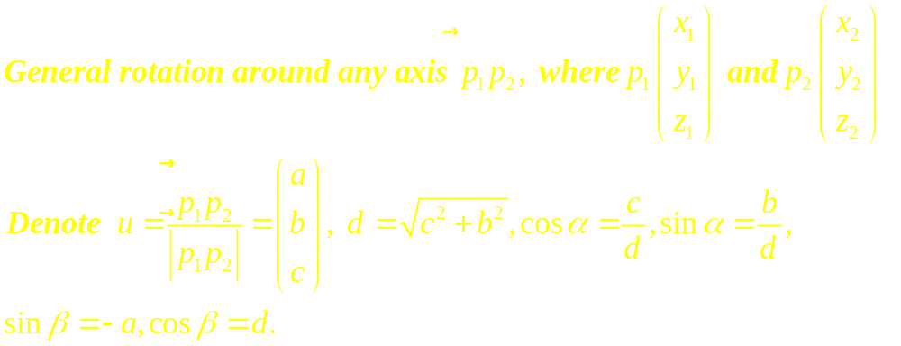
y
u
Implementation method
Step1: Translate p₁ to the origin
Step2: Rotate p₂ onto the z axis
Step3: Rotate the object around the z axis
Step4: Rotate the z axis onto the original orientation
Step5: Translate p₁ to the original position
d
x
z

Slide 24
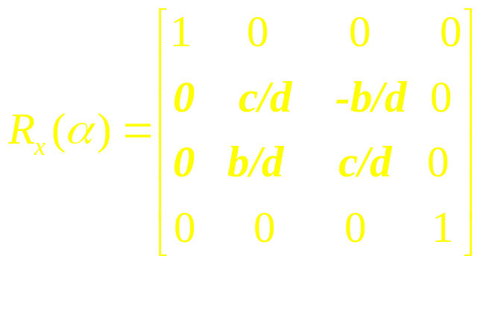
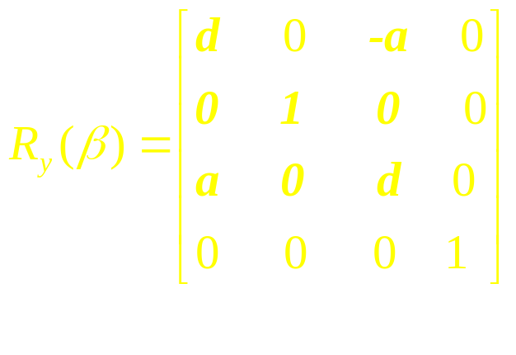
Transformation matrices in each step
Step1: Translation matrixT(-x₁,-y₁,-z₁)
Step2: Rotation matrix R_{y}(β)R_{x}(α)
Step3: Rotate the object around the z axis R_{z}(θ)
Step4: R_{x}(-α) R_{y}(-β)
Step5: T(x₁,y₁,z₁)

Slide 25
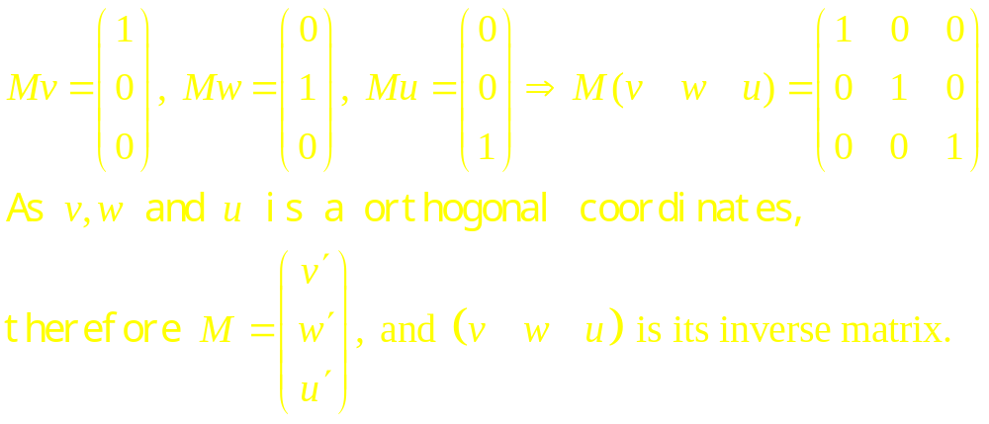
Another method to construct rotating transformation in
Step2 and its inverse transformation in Step4.
First, we find two orthogonal unit vectors v and w in the plane normal to the vector u. Second, construct rotating ransformation M so that v, w and u become x, y and z axes of the new coordinates, i.e.
y
u
v
x
z
w

